Slide 1
Video Game Analysis &
Technical Design
  Ch.4 Action, Strategy, RPG & Sports Games

Slide 2
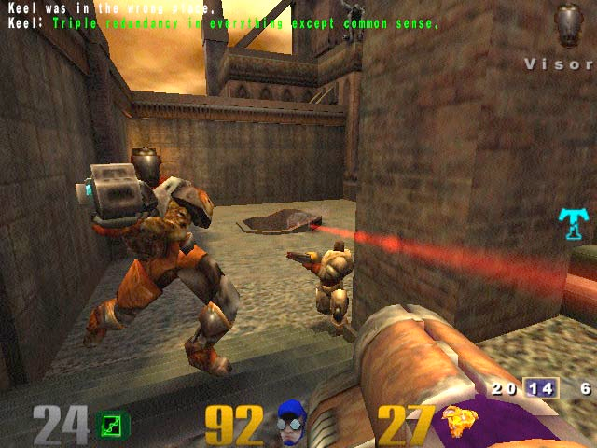
What Are Action Games?

Slide 3
What Are Action Games?
An action game is one in which the majority of challenges presented are tests of the player’s physical skills
Puzzle-solving, tactical conflict, and exploration challenges are often present as well
Fastest action games are twitch games

Slide 4
Action Game Subgenres
Shooters
  Most familiar and popular subgenre
  Players use a ranged weapon
  2D shooters
    Top-down or side-view perspective
    Players are under constant attack so shoot everything
    Unlimited ammunition
    Unrealistic physics

Slide 5
Action Game Subgenres
Shooters
  3D shooters
    Cutting edge of game hardware
    Physics are more realistic than 2D shooters
    Can be first-person or third-person perspective

Slide 6
Action Game Subgenres
Platform games
  Cartoonish games in which an avatar moves through a vertically exaggerated environment, jumping on and off platforms
  Most actions are jumps
  Highly unrealistic physics
  Most 2D side-scrolling games with humanoid avatar are platform games
  Super Mario Bros. is the classic example

Slide 7
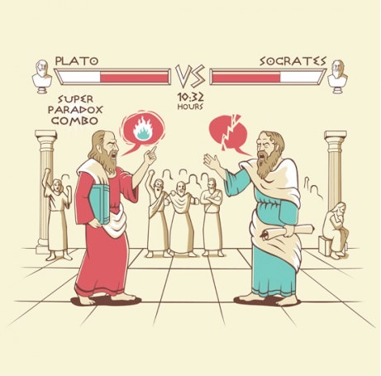
Action Game Subgenres
Fighting games

Slide 8
Action Game Subgenres
Fighting games
  Physical challenge tests reaction time and timing
  Simulate hand-to-hand combat; may use local effect weapon such as a sword
  Actions include maneuvering the fighter, attacking, and defending
  Combo moves are common
  Play is largely 2D in the plane of the video screen

Slide 9
A bit more on video game violence
We live in a violent society.
  It has been like that for all of human history.
    If all video games were nonviolent, then the video game industry probably wouldn’t exist - people would search out other venues for entertainment that are more realistic within today’s societal context.
    Like books and television, violent video games have been studied – and what has been found is that all three media (books, television and video games) are very good at reassuring people’s behaviors, but not changing them.
    In other words, video games don’t teach violence……and neither do books or television.

Slide 10
A bit more on video game violence
  Today, people of all ages play video games, and they have a smorgasbord of games to choose from, and over three quarters of them don’t have violence at all!
    However, society often looks for simple reasons for problems, and video games have always been a popular target for blame.
    For example, after a recent gun shooting in the U.S., Joe Biden announced that he wants to meet with video game developers to discuss how to deal with gun violence in the United States. This is essentially the same as wanting to meet with Mattel, the makers of Hot Wheels toys, to discuss car safety for the automotive industry.

Slide 11
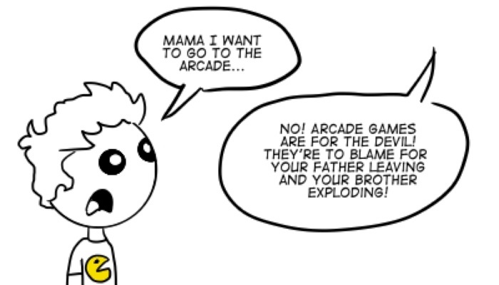
A bit more on video game violence
  Unfortunately, the stigma surrounding video game violence is likely always going to be something that video game developers have to live with.

Slide 12
Action Game Subgenres
Fast puzzle games
  Require player to solve problems quickly
  Simple, abstract, limited control set
  Tetris is the archetypal fast puzzle game
  Casual gamers enjoy this subgenre
  Ideal for handheld devices and cell phones

Slide 13
Action Game Subgenres
Action-adventure
  Hybrid combines action and adventure
  Games include physical challenge, story, inventory, and dialog
Dance and rhythm games
  Challenges player’s sense of rhythm
  Press buttons to make the avatar dance
    Specialized hardware common: dance mat, conga drums, maracas
  Popular with girls—less pointless violence

Slide 14
Action Game Subgenres
Other action games
  No shooting, hand-to-hand fighting, or abstract puzzle-solving
  Use skills such as maneuvering and path planning

Slide 15
Game Features
Progression
  Levels usually completed in linear sequence
    Levels often grouped by theme and end with a boss
    Fixed challenges are easier to build, but repetitious
  If killed, avatars reappear at a checkpoint
  Level exits, level warps, and teleporters
    Level exits lead to the next level
    Level warps exit the level and jump ahead several levels
    Teleporter jumps within the same level

Slide 16
Game Features
Challenges
  Avatars typically faced by three kinds of problems
    Passive obstacle impedes movement without threat (wall)
    Stationary danger attacks approaching avatar (electric fence)
    Active dangers attack and move around

Slide 17
Game Features
Challenges
  Waves
    Enemies attack in groups
  The big boss guards the end of the themed level
  Wildcard enemies break up the predictability
  Locked doors partition levels and control progress
  Monster generators or spawn points cause new enemies to appear

Slide 18
Game Features
Player actions
  Routine actions include maneuvering an avatar, aiming and shooting, collecting and selecting, manipulating objects, and fighting moves
  Smart bomb clears enemies from the immediate area
  Hyperspace escape immediately moves the player at the risk of unexpectedly entering a dangerous area

Slide 19
Game Features
Core mechanics are simple and obvious
  Lives provide several reprieves from death
  Energy is replenished by collectibles or powerups
  Powerups increase strength
  Collectibles are common but not required
    Increase the score
    Unlock secret levels or cause special bonus events

Slide 20
Game Features
Core mechanics
  Timer counts down time to events and catastrophes or the amount of time left to finish the level
  Score indicates progress

Slide 21
Game Features
Victory conditions
  Only arcade games don’t have victory conditions
    Players must lose arcade games to keep putting in money
  Including a structured story means the game will end
Interaction model
  Avatar is most common
  Puzzle manipulation model (Tetris) or omnipresent model (Lemmings) also used

Slide 22
Game Features
Perspective
  2D perspectives
    Include side-scrolling and top-scrolling
    Continuous, variable, and parallax scrolling
  3D first person is tied to the avatar with a limited field of view
  3D third person lets the player see the avatar

Slide 23
Game Features
Perspective
  Gameplay implications of 2D and 3D
    In 3D, it is difficult to tell the speed or distance of objects that come directly toward the player
    3D games use the environment to present challenges
    In 3D, enemies can hide and sneak up on the avatar
  Context-sensitive perspective
    Camera moves depending on the circumstances
    Not a good perspective for fast action games
      Sudden changes of camera position are disorienting during high-speed action

Slide 24
Game Features
User interface features
  Keep it onscreen
  Use indicators rather than numbers or text
  Maps and mini-maps can be shown as transparent overlays
  Use color to identify characters and objects
  Controls should be as simple as possible

Slide 25
What Are Strategy Games?
The majority of challenges are strategic conflict
Player chooses from a variety of potential actions or moves at most points in the game
Victory is attained by superior planning and taking the best actions; chance must not play a large role
Other challenges may also be present; physical challenges play little or no part

Slide 26
Game Features
Two main subgenres
  Classical turn-based games
    Pure strategy games tend to be turn-based
    In multiplayer turn-based computer games, players often choose their next move simultaneously
  Real-time strategy games
    Developed after turn-based games
    RTSs add time pressure to strategy games

Slide 27
Game Features
Challenges
  Strategic conflict
    Conflict is combat between groups of units
    Factories generate more units
    Players can choose from among a variety of units
  Diplomacy and espionage offer alternatives to combat

Slide 28
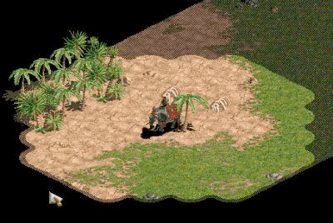
Game Features
Challenges
  Exploration challenges
    Allow players to investigate unknown territory
    Fog of war
      Unexplored areas shown in black and explored but unpatrolled regions shown dimly
  Economic challenges
    Players can collect resources to buy units
    If the economy is complicated, the game is actually a hybrid game made up of a strategy game and a construction and management game

Slide 29
Game Features
Player actions involve giving orders to units
  Move to a location
  Attack
  Stop moving
  Hold a position
  Establish a formation
  Produce new units

Slide 30
Core Mechanics
Designing units
  Units usually fall into types so that all units of a type share a set of attributes
  Some units will also have special unique capabilities
  Rock-paper-scissors (RPS) model is suited only to simple games
    Cannot be balanced for complex game
    Doesn’t take into account battlefield conditions

Slide 31
Core Mechanics
Designing units
  Modern war games use numeric attributes to describe unit’s abilities
  Numeric attributes used more often are:
    Health
    Weapons
    Range
    Shot mass and velocity (or power)
    Accuracy
    Defensive dodging
    Speed
    Turn rate
    Mass and acceleration
    Range of vision

Slide 32
Core Mechanics
Designing units
  Special capabilities include:
    Stealth
    Flying or sailing
    Repair
    Transport
    Building construction and production of mobile units
    Leadership
    For every special capability you create for one side, you must also create a capability of similar military value for the other side OR a way to defeat the special capability

Slide 33
Core Mechanics
Designing units
  Computing the relative value of units
    Value based on time and resources
    Equation for attack units:
    Attack unit value = maximum health × shot power
    × rate of fire × theoretical accuracy
    × range × maximum speed
    Equation for defensive units:
    Defense unit value = maximum health × shot power
    × rate of fire × theoretical accuracy
    × (range² ÷ 2)

Slide 34
Core Mechanics
Designing units
  Production rates, unit numbers, and Lanchester’s laws
    Lanchester’s Linear Law: In hand-to-hand combat, the relative strengths of two armies are simply proportional to their numbers of troops
    Lanchester’s Square Law: For units that can aim and shoot at one another from a distance and can concentrate their fire, the strength differential is proportional to the square of their sizes

Slide 35
Core Mechanics
Health, morale, and fighting efficiency
  Units normally fight at full efficiency until their health points are gone
  Morale is represented by a number that increases or decreases an army’s fighting effectiveness
  Leadership bonus works better than diminishing fighting effectiveness in proportion to health or morale losses, because it doesn’t involve positive feedback

Slide 36
Core Mechanics
Upgrades and technology trees
  Researching upgrades
    Player must initiate research
    Organize upgrades into a sequence
    Allow player to choose upgrade to research
  Upgrades can be applied to single units, unit types, or globally
  Upgrades can be temporary or permanent
  Create a technology tree to organize large numbers of upgrades

Slide 37
Core Mechanics
Logistics
  Management of supply: the production, distribution, maintenance, and replacement of personnel and materials
  Supplies and consumable items
    Don’t track food and fuel
    If ammo is cheap and quickly expended, provide unlimited supply
    Highly destructive ammo should be rare and tracked

Slide 38
Core Mechanics
Logistics
  Supply lines
    Route over which fresh troops and war materiel must be transported from their source to where they are needed
    Cutting the supply line is a classic strategy
    Most computer war games model supply lines correctly for the troops but not the supplies
      Players don’t want to manage supplies
      Realistic supply lines mean creating transport units and modeling the supplies as individual objects

Slide 39
Core Mechanics
Logistics
  Abstracting the distribution process
    Completely abstracting distribution can cause exploits
    Alternative is verifying that supply routes are open, but don’t actually require transport
  Road-building
    Build roads to access resources
    Roads provide supply routes

Slide 40
Core Mechanics
Logistics
  Influence maps
    Any unit within a certain distance from a supply depot can receive supplies
    Unobstructed route not required

Slide 41
The Game World
Historical settings
  Military strategy games tend to be set in the past
  Historical setting will be scrutinized for accuracy by players familiar with the event
  World War II market oversaturated
  Need a less popular time period or unique approach

Slide 42
The Game World
Modern settings
  Risks generating controversy and negative public opinion
  Must be rigorously accurate and politically neutral
  Must address the issue of battlefield scale

Slide 43
The Game World
Future (science fiction) settings
  Popular and allow a lot of scope for invention
  Might not catch public’s imagination
  Use technology carefully
  Define terminology
  Must address the issue of battlefield scale

Slide 44
The Game World
Fantasy settings
  Use magic rather than technology
  More emphasis on close-range and hand-to-hand combat

Slide 45
The Presentation Layer
Interaction model
  Large scale
    Player indirectly controls units and has godlike view of the game world
  Squad scale
    Smaller group of 20 individual units
Perspective
  Players need to see the big picture
  Aerial perspective needed

Slide 46
The Presentation Layer
User interface
  Player must control action at different scales
  Usually present related data in separate windows
  Make unavailable options gray
  Provide beginner and advanced modes for commands
  Group commands by function

Slide 47
Artificial Opponents
Game tree search
  Game tree is the set of all possible future moves
  This approach works for only the simplest games
Neural net
  Mimics the brain’s ability to recognize and correctly identify patterns of data
  Not currently used in consumer games

Slide 48
Artificial Opponents
Hierarchical finite state machines
  Most successful mechanism for creating AI opponents in war games
  What is a finite state machine?
    Conceptual machine rather than a piece of mechanical engineering
    Its rules establish a simple behavioral system for an individual automated character
    Define each state and condition or event that causes transition to a new state

Slide 49
Artificial Opponents
Hierarchical finite state machines
  Hierarchical finite state machines in games
    Ones higher up in the hierarchy give orders to the ones lower down
    Higher FSMs can order lower FSMs to change state
AI alone usually can’t beat a human player except in simple games
Most AI opponents get other advantages
  Human doesn’t know where his enemy is
  Designer gives AI more resources to start with

Slide 50
What Are Role-Playing Games?
Overview
  Objective is to experience a series of adventures in an imaginary world, through an avatar or a small group of characters whose skills and powers grow over time
  Essential parts are the quest or story and character growth
  Victory consists of completing the quests

Slide 51
What Are Role-Playing Games?
CRPGs and war games
  Both include combat governed by rules
  CRPGs
    Small group of characters who exhibit growth; no factories to produce more units
  War games
    Large group of identical units; factories produce more units

Slide 52
What Are Role-Playing Games?
CRPGs and action games
  CRPGs
    Tactical challenges
    Non–action-related activities such as buying and selling as well as conversations with other characters
  Action games
    Physical challenges
    Non–action-related activities are rare

Slide 53
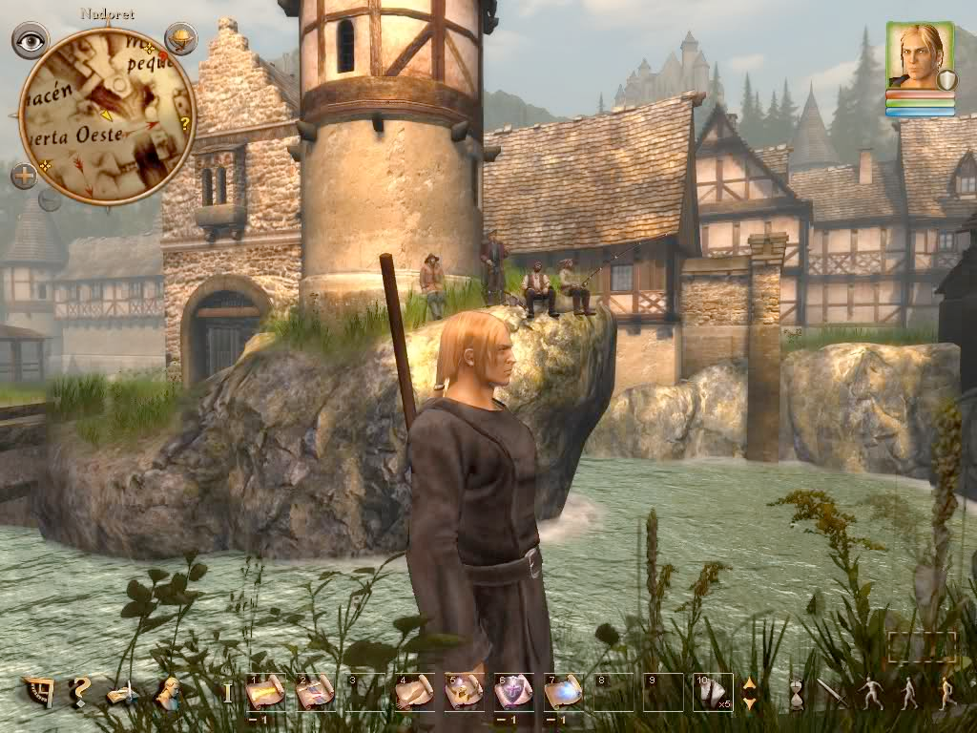
What Are Role-Playing Games?

Slide 54
What Are Role-Playing Games?
CRPGs and adventure games
  Both have rich storylines, highly detailed characters, and exploration challenges
  CRPGs
    Player-defined character
    Characters defined by numeric attributes that improve over time
    Complex internal economy
  Adventure games
    Avatar provided by the game
    Concentrate on a single character
    Puzzle challenges
    No numeric attributes
    Personal growth

Slide 55
Game Features
Exploration and combat make up a big part of most CRPGs
Themes
  Saving the world is a common theme
  Try a unique approach
Progression
  Long quest broken into episodes
  Major challenge at the end of each episode
  Optional side quests

Slide 56
Game Features
Gameplay modes
  Exploration and combat
    Actions include setting a destination, designating an NPC to attack, and using special skills
  Conversation
    Uses dialog tree
  Trade
    Buy and sell items
  Inventory
    Manage carried objects

Slide 57
Core Mechanics
Rolling dice
  Know the probabilities to get the result you want
Character attributes
  Characterization attributes
    Determine general abilities and qualities; change infrequently
      Race
      Sex
      Character class
      Physical, mental, moral, and social attributes

Slide 58
Core Mechanics
Character attributes
  Status attributes, experience, and character levels
    Attributes that change frequently
    Experience points and character level measure the character’s growth
  Cosmetic attributes add richness to the game

Slide 59
Core Mechanics
Magic and its equivalent
  Concept that allows characters to influence the world, themselves, or other characters, by means not available to us in real life
    Science fiction implements magic as “advanced technology”
  Use of magic restricted by character class
  Define magic, how it’s invoked, and how it’s limited

Slide 60
Core Mechanics
Skills and special capabilities
  Obtaining new skills for a character is similar to upgrading a unit in a strategy game
  Skill trees provide a growth path similar to a tech tree in war games
Character design
  Most CRPGs allow the player to create the character
  Roll dice to generate points to distribute among character attributes

Slide 61
The Game World and Story
Settings
  Tend to be fantasy and science fiction settings
  Must be appealing to explore
  Some CRPGs provide an editor to enable players to create scripted adventures in the game world

Slide 62
The Game World and Story
Story
  First, determine the game’s overall quest
    The ending
  Then, design the episodes that the player experiences from the beginning to the end
  Add side quests
  Write an enticing opening

Slide 63
The Presentation Layer
Interaction model
  Party-based in single-player CRPG
    Avatar-based is becoming more common, however
  Avatar-based in multiplayer online games
Perspective
  First person or third person for avatar-based models
  Aerial perspective allows player to see all members of the party at once as well as surrounding terrain

Slide 64
The Presentation Layer
User interface
  Wide range of actions
    Interface can be complex
  Hide the mechanics to aid the player’s immersion
  Repetitive tasks
    Instead of making the player try repeatedly, automate the repetition and show a progress bar
      If the character has low skill at the task, it will take a long time
      Allow the player to interrupt and abandon the attempt

Slide 65
What Are Sports Games?
A sports game simulates some aspect of a real or imaginary athletic sport, whether it is playing in matches, managing a team or career, or both
Match play makes use of physical and strategic challenges
The management challenges are chiefly economic

Slide 66
Game Features
Game structure
  Main gameplay mode is match play
  Outside of match play, game’s modes relate to other aspects of the sport
  Pause the game for coaching tasks
Player roles
  Athlete is most common role
    Player follows the action rather than a single athlete in team sports
  Player may also take role of coach or manager

Slide 67
Game Features
Gameplay and rules
  Challenges and actions match the sport
    Athlete
      Physical challenges
    Coach
      Strategic challenges
  Rules might have to be relaxed because controlling athletes onscreen does not correspond exactly to real-life sports experiences
  Need to decide what to do about athlete mistakes outside of player control
    Allow players to set referee parameters

Slide 68
Game Features
Competition modes
  All competition modes are allowed
  Sports games are more popular on consoles to permit multiplayer competition
  One mode should include computer versus itself so players can watch a match

Slide 69
Game Features
Victory and loss conditions
  Match real sport’s victory and loss conditions
  Modes
    Season mode
    Exhibition mode
    Sudden death
    Round robin
    Tournament mode
    Franchise mode

Slide 70
Game Features
Opportunities for creative play
  Team creation
    Players create their own teams
  Strategy design
    Players can create their own strategies
  Playing field design
    Players can edit the shape of the playing field if sport allows this option

Slide 71
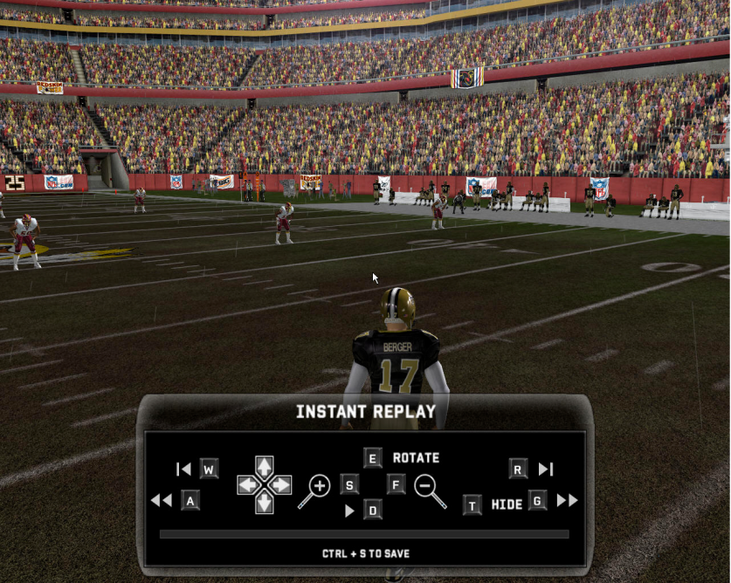
Game Features
Inventing a sport is a risky option that is hard to sell
Weather
  Weather can invoke special rules
  Weather affects the game
Instant replay is an essential feature

Slide 72
Core Mechanics
Physics for sports games
  Physics engine determines the behavior of moving bodies in the match
  Physics should not be perfectly realistic because
    Player does not have precise control
    Player is not a professional athlete

Slide 73
Core Mechanics
Rating the athletes
  Developing ratings is a big task
  Ratings provide data for the physics engine to simulate the athletes accurately
  Common ratings are provided for all athletes
    Speed, agility, weight, etc.
  Specialized ratings apply to specific positions
    Passing strength, passing accuracy, etc.

Slide 74
Core Mechanics
Athlete AI design
  Define the state space
    Play in a match is broken into states defined by rules and strategy
      i.e. fly ball, foul ball, grounder, strikeout
    Create a flowchart to map the game’s states
  Set collective and individual goals in each state
    Individual goals are what each athlete tries to achieve in the course of playing his position
    Collective goal is what the team is trying to achieve as a whole; the collective goal determines individual goals

Slide 75
Core Mechanics
Injuries
  Injuries introduce some chance
  Allow players to turn off injuries
Arcade mode versus simulation mode
  Arcade mode increases action and decreases realism; produces higher scores
  Simulation mode increases realism but probably decreases action

Slide 76
Core Mechanics
Simulating matches automatically
  Computer plays out matches and records results
  To fake results quickly, roll dice to generate game scores
    Scores must be restricted to a credible range
    Doesn’t generate other statistics
  Allowing a home field advantage is not recommended

Slide 77
The Game World
Setting
  Accurate copies of real stadiums and arenas
  Weather significantly affects games played outdoors
  Crowd noises contribute to setting

Slide 78
The Game World
Licenses, trademarks, and publicity rights
  Team and league trademarks
    In America, the league holds the license to use the team and league names, logos, uniform designs, etc.
    A variety of governing bodies manage individual sports
    Events are owned by the organization producing them
    Stadiums are now asserting trademark rights too
  Personal publicity rights owned by the athlete or an organization

Slide 79
The Game World
Audio commentary
  Needed to feel like you’re watching the match on television
  Play-by-play and color commentary
  Note the events that should trigger a specific comment

Slide 80
The Presentation Layer
Interaction model
  Player usually controls an avatar
  Which athlete is being controlled can change as the play progresses (in team sports)
Perspective
  Don’t use first-person
  Players watch the athletes
  Overhead
    Individual sports
  End view or side view
    Team sports
  Picture-in-picture
    Sports with more than one focal point
      i.e. baseball or cricket

Slide 81
The Presentation Layer
User interface design
  User interface can change every second, depending on conditions in the match
  Each state requires a set of options
  Mark the controlled athlete with a label
  Use overlays rather than pull-down menus

